Slide 1
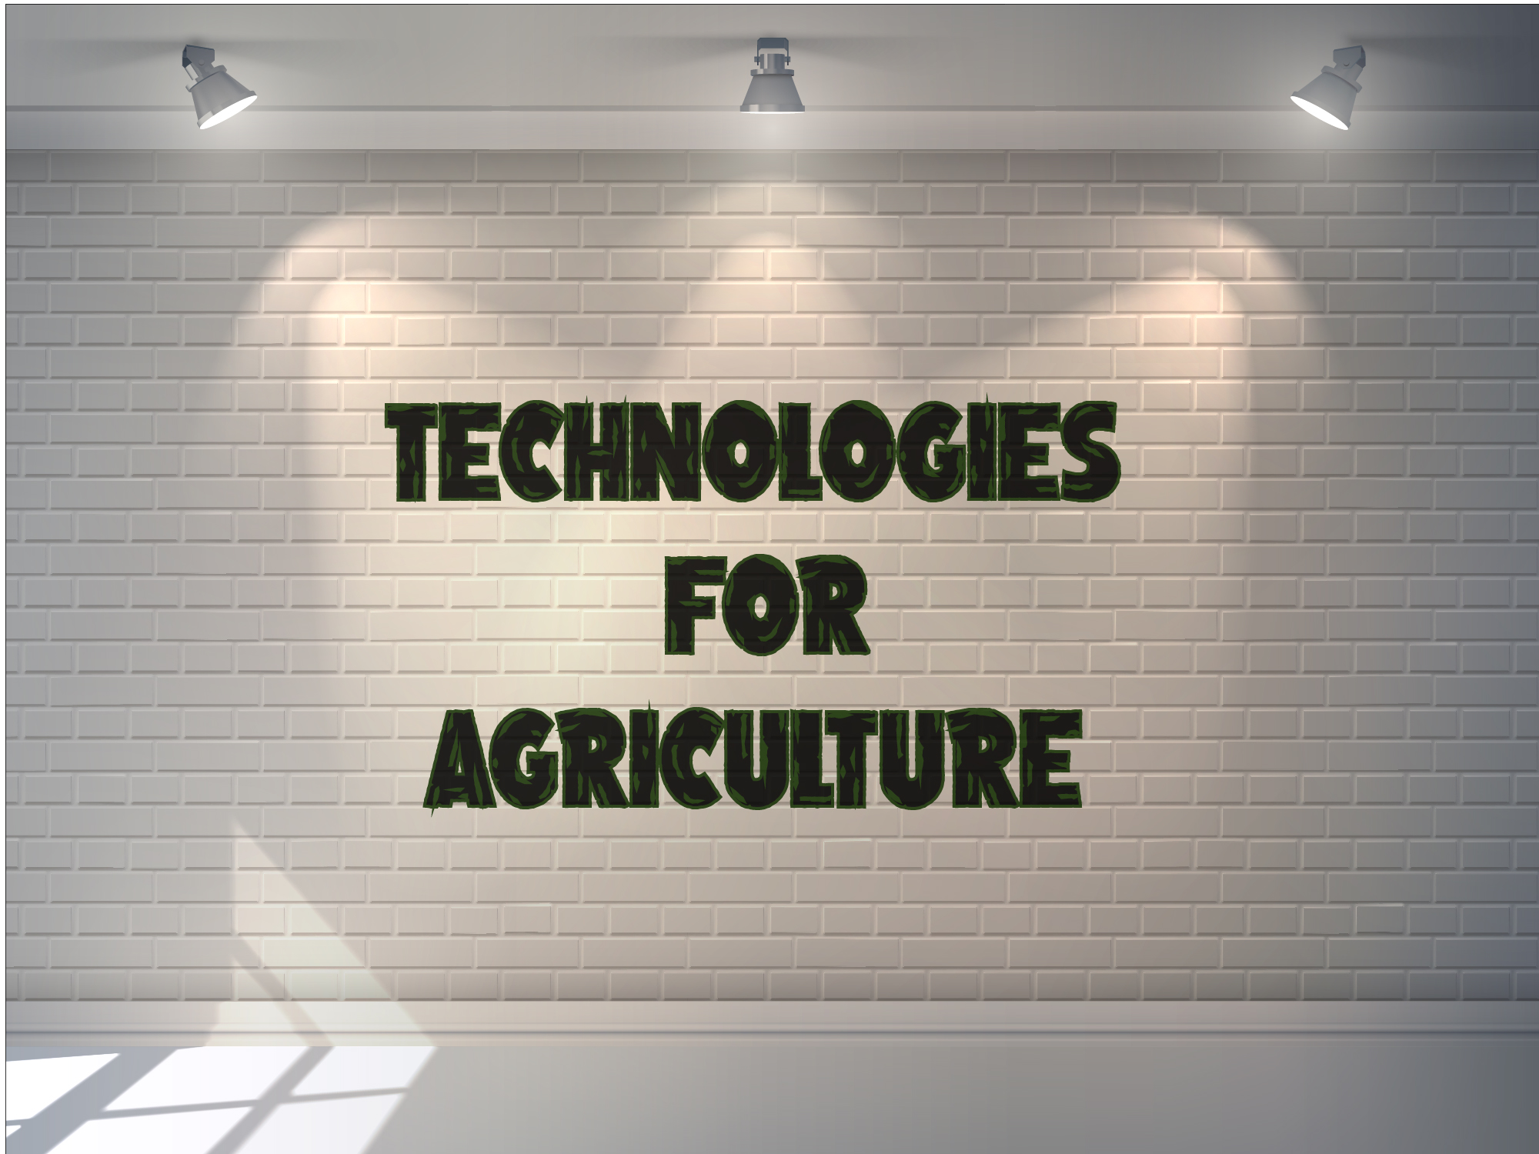


Slide 2

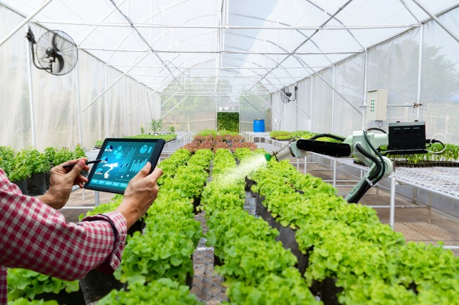
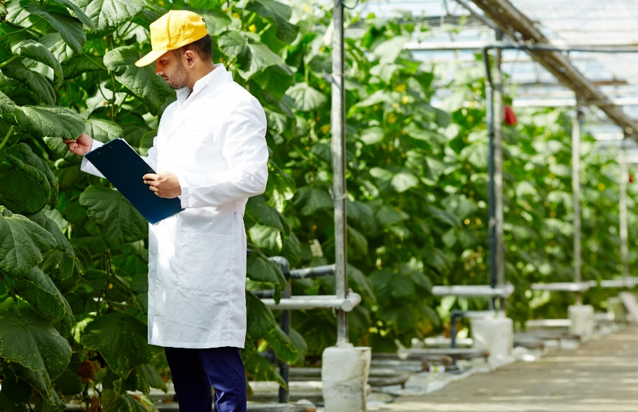
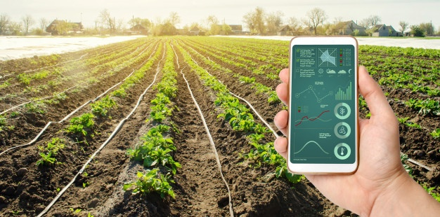
AGRICULTURE TECHNOLOGY OR AGROTECHNOLOGY
Is the use of technology in agriculture , horticulture, and aquaculture with the aim of improving yield, efficiency, and profitability. Agricultural technology can be products, services or applications derived from agriculture that improve various input/output processes. A major turning point for agricultural technology is the Industrial Revolution
.

Slide 3
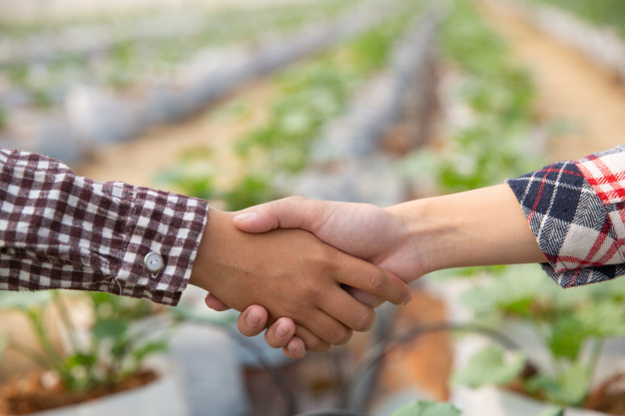
Mobile application for agriculture
There is a Nigeria's digital agriculture platform which focused on connecting farm sponsors with real farmers in order to increase food production while promoting youth participation in agriculture.
This agricultural technology startup is currently disrupting the agriculture ecosystem in the country by connecting small-scale farmers with investors using their platform App which is available on Google and Apple app stores.
Farmers and sponsors all receive a percentage of the profits on harvest. The platform also makes provision for insurance cover for all existing farm projects, so that in the event of unforeseen circumstances, the sponsors’ capital can be refunded.

Slide 4
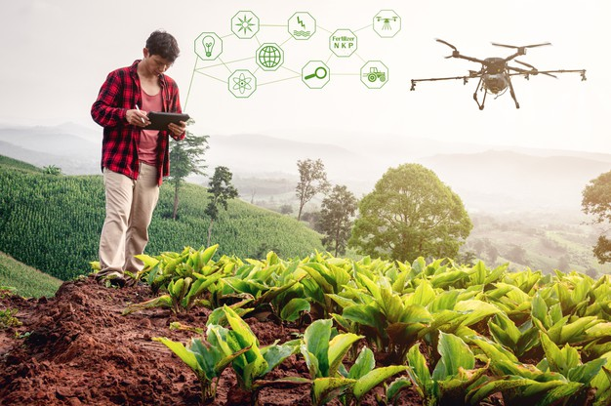
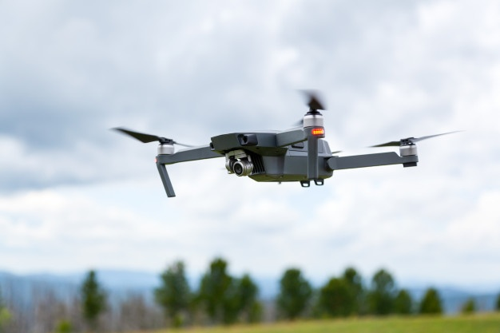
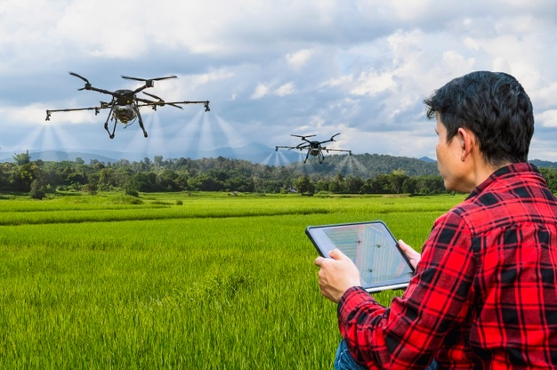
Drones for agriculture advancements
Drones can be used on Crop field for scanning with compact multispectral imaging sensors, GPS map creation through onboard cameras, heavy payload transportation, and livestock monitoring with thermal-imaging camera-equipped drones.
High-income countries have seen recent improvements in their agricultural management systems through modern remote sensing technology, such as satellites and aircraft and the information they collect. Out of the vast amount of data collected, advice is provided to farmers and fishers to help inform their decisions.
This has led to better crop yields, higher quality produce and more sustainable agricultural practices in some cases. Big data also informs high-level decision-makers on how to better manage food supply at national and regional levels.

Slide 5
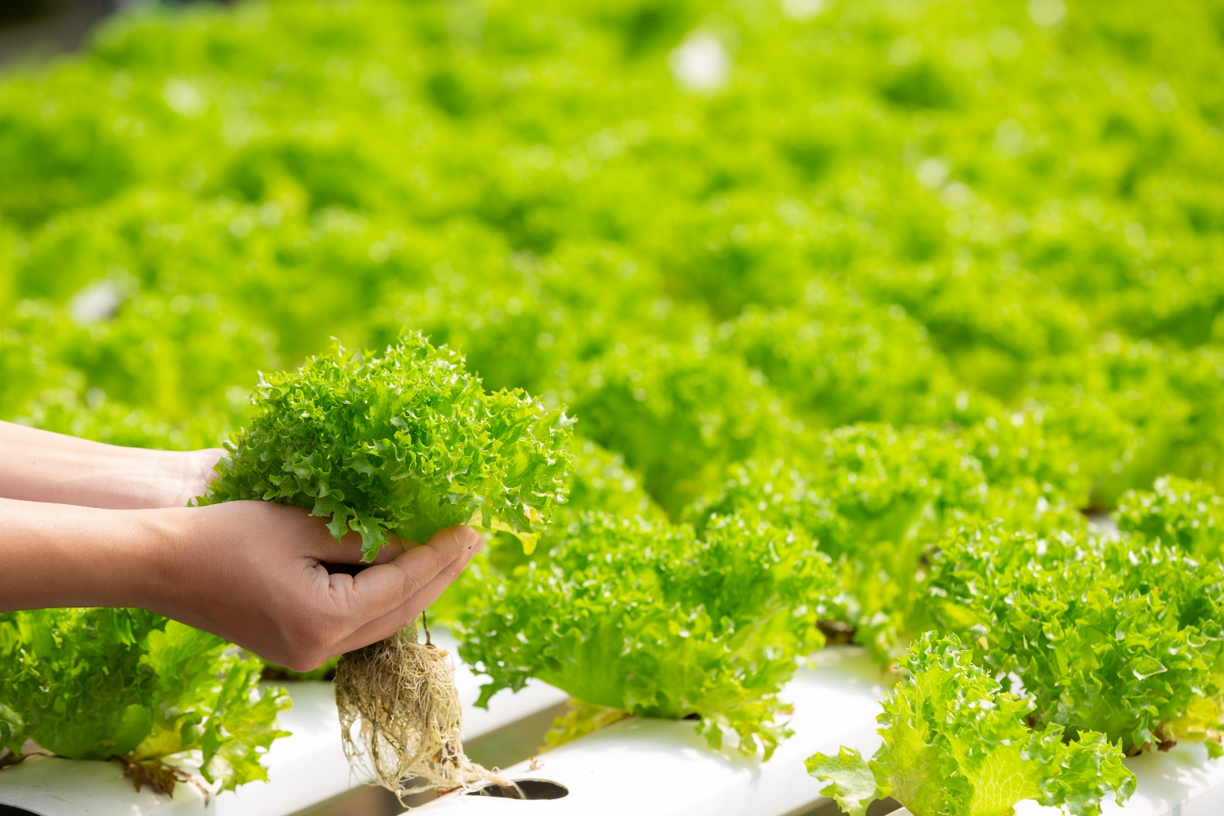
Hydroponics Technology
Hydroponics is a soilless farming technology that is used to grow vegetables and tomatoes.
It guarantees an all year round production for farmers and insulates these crops from the effects of climate change.

Slide 6

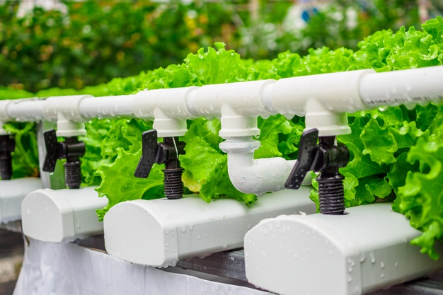
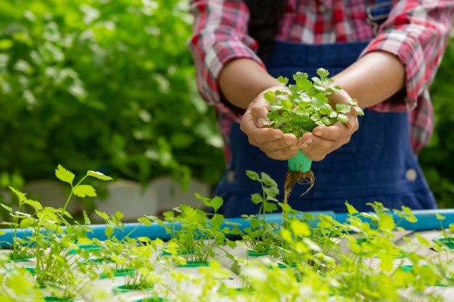
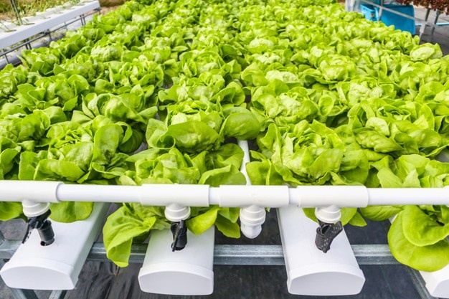
Hydroponics Saves Water
Hydroponic plants can grow with just 5-10% of the water that’s need with soil. This is of enormous benefit in areas with scarce water resources and is a major environmental benefit of hydroponic cultivation.

Slide 7

Security
Farms, worksites and livestock can unfortunately be a target for theft. However, remote security cameras are gaining popularity and are relatively inexpensive . Cameras are easy to set up and install and usually only require batteries

Slide 8
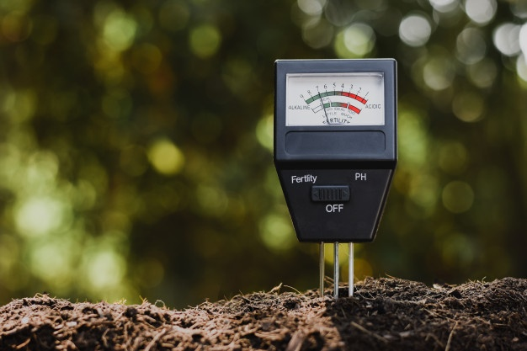
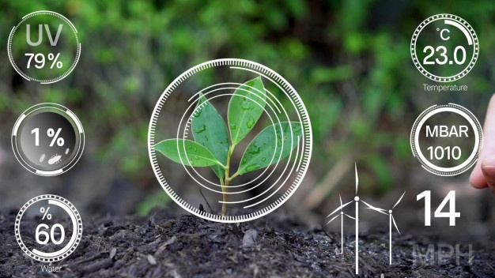
Soil moisture sensors (irrigation) plant and soil health
Soil moisture sensors can be used to monitor the moisture level of soils, which is particularly useful for irrigators.
Knowing how much moisture is in the soil allows the farmer to use their water more effectively and sustainably

Slide 9
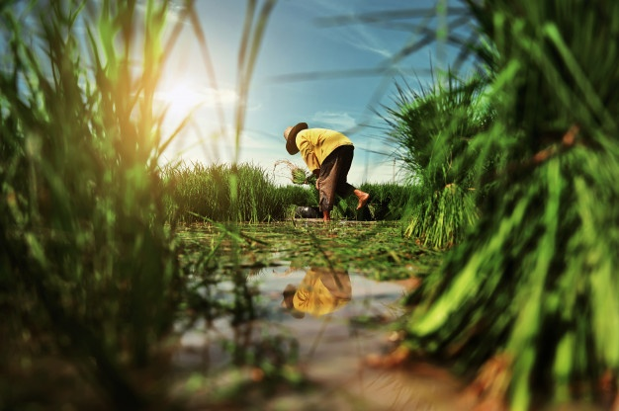
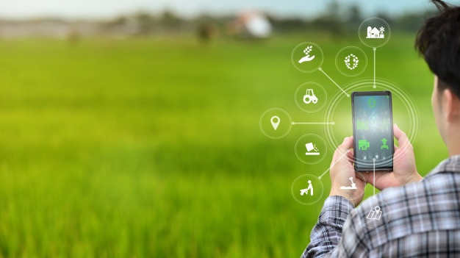
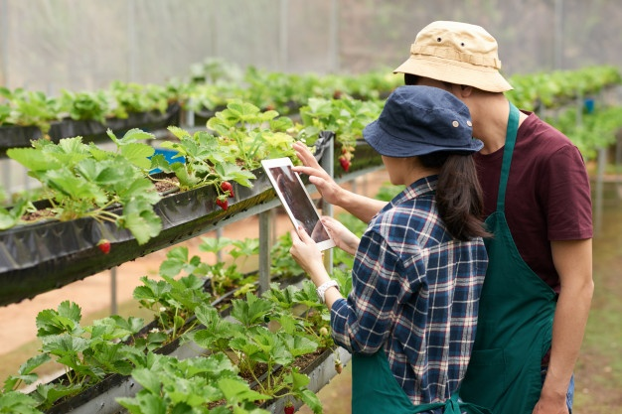
Agriculture has been wrongly perceived in the past as a "dirty job" for the old people in rural communities but with the renaissance Technology brought to Agriculture, young people now see it as a potential sector to explore.

Slide 10
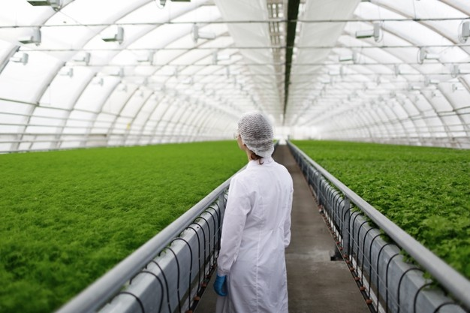
Israeli technology to transform Indian agriculture.
Agriculture, the backbone of Indian economy, has been facing various challenges in recent years - lower productivity, resource crunch and erratic weather, all of these translating into lower returns.
Israeli water management technology to help Indian farmers
A well established leader in water management, desalination and recycling techniques, Israel has set a template for reusing wastewater for irrigation. It treats 80 per cent of its domestic wastewater, which is recycled for agricultural use and constitutes nearly 50 per cent of the total water used for agriculture. Drip irrigation is one of the most effective forms used by farmers in many developed nations.
The collaboration with Israeli agricultural technologies helped in bringing the most advanced innovations to the India farmers at affordable prices by adopting the concept of Technology transfers leading to "Make in India"

Slide 11


Bonsai ("tray planting") is a Japanese art form using trees grown in containers
In the most restrictive sense, "bonsai" refers to miniaturized, container-grown trees adhering to Japanese tradition and principles.
Bonsai does not require genetically dwarfed trees, but rather depends on growing small trees from regular stock and seeds. Bonsai uses cultivation techniques like pruning, root reduction, potting, defoliation, and grafting to produce small trees that mimic the shape and style of mature, full-size trees.

Slide 12
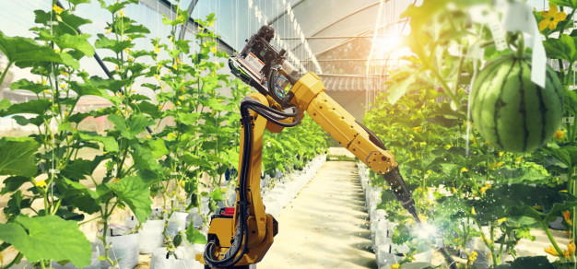
IMPORTANCE OF AGRICULTURAL TECHNOLOGY
Higher crop productivity
Decreased use of water, fertilizer, and pesticides, which in turn keeps food prices down
Reduced impact on natural ecosystems
Less runoff of chemicals into rivers and groundwater
Increased worker safety

Slide 13
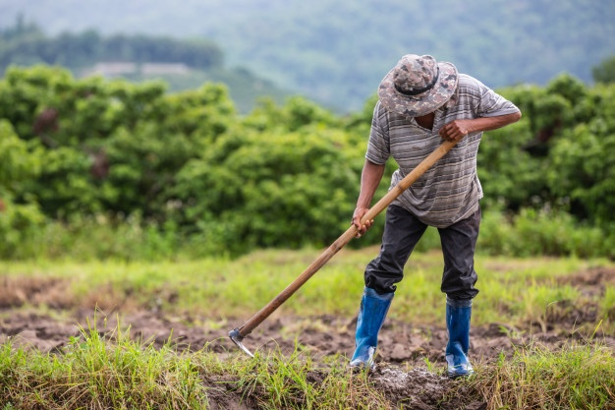
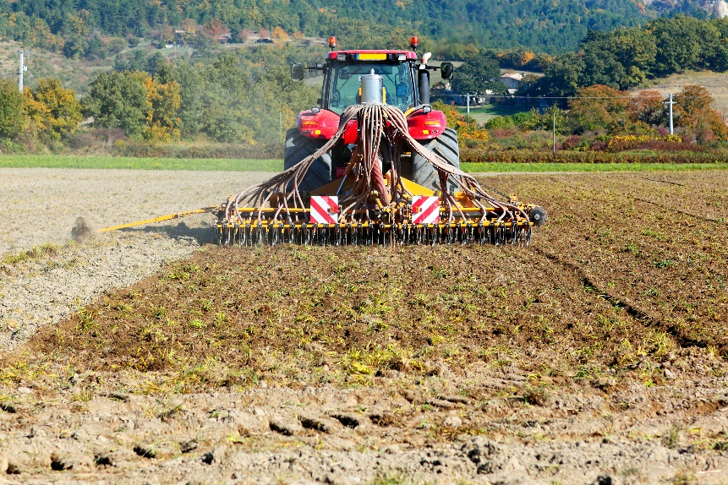
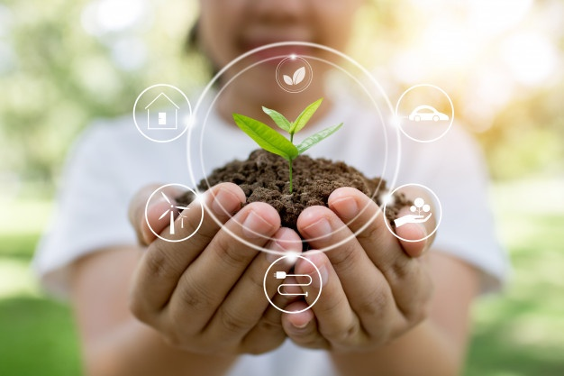
In addition, robotic technologies enable more reliable monitoring and management of natural resources, such as air and water quality. It also gives producers greater control over plant and animal production, processing, distribution, and storage, which results in:
Greater efficiencies and lower prices
Safer growing conditions and safer foods

Slide 14

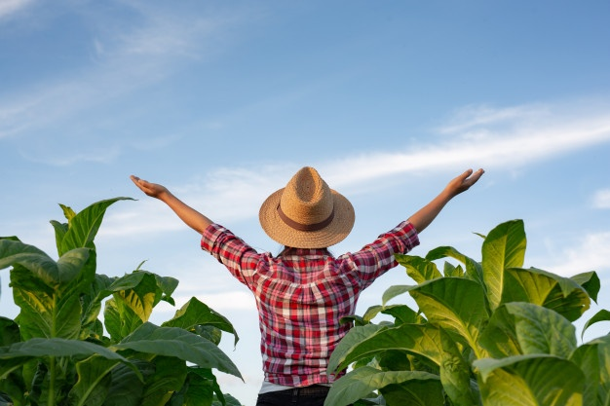
THANK YOU

